Slide 1
Scientific Method Review

Slide 2
Board Layout

Slide 3
Testable Question
Definition
A testable question is one that can be answered by designing and conducting an experiment.
Bad Example
What temperatures do plants like?
Good Example
Does the number of seed germinations depend upon the environment’s average temperature?

Slide 4
Variables
Dependent variable
The factor measured or observed during an experiment
Independent variable
The factor that you want to test
Changed by the investigator to observe how it affects a dependent variable
Constant
Any factor in the experiment that remains the same
Example cont’d.
Dependent variable
# of seed germinations
Independent variable
Environment temperature
Constant
Same plant
Same soil
Same amount of sunlight
Same amount of water

Slide 5
Hypothesis
Definition
A testable statement about what is going to happen in the experiment.
If…then…because…
Bad Example
I think the plants will grow better in warmer temperatures because that way they won’t freeze.
Good Example
If seeds are planted in homogeneous environments, besides the temperature, then the number of seeds germinating will increase as the temperature increases because the majority of plants need a warm environment to grow.

Slide 6
Materials
Definition
A list of supplies and equipment needed for the experiment.
Bad Example
Seeds
Water
Soil
Thermometer; etc.
Good Example
5 seeds per pot or a total of 25 seeds
5 plant pots
1 10kg bag of soil
20mL or water per pot per day, etc.

Slide 7
Procedure
Definition
A detailed step-by-step description of the experiment.
Bad Example
1. Get supplies
2. Plant seeds
3. Set temperatures
4. Water plants
5. …and so on
Good example
1. Gather all listed materials
2. Place 2kg of soil in each of the five plant pots
3. Carefully place five seeds in each of the five pots evenly distributed throughout the soil surface
4. …and so on

Slide 8
Data
Definition
Detailed qualitative and quantitative observations about what happened in the experiment.
Ex. Graphs, Charts, Tables

Slide 9
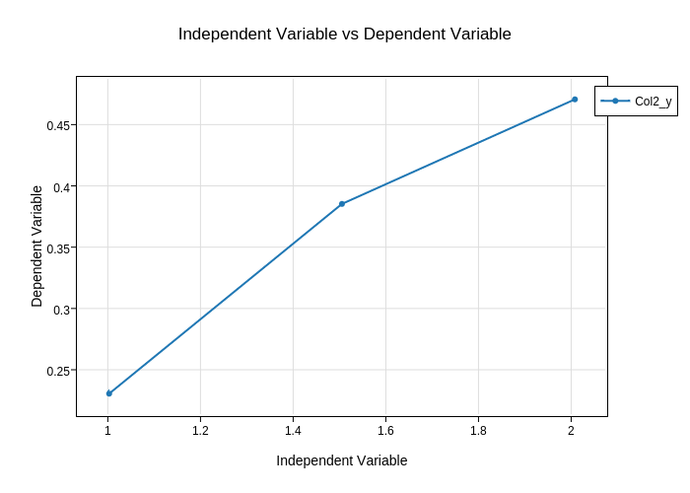

Slide 10
Data Analysis
Bad Example
My hypothesis was supported. I found seeds do germinate more when its hotter.
Good Example
The hypothesis for this experiment was, “If seeds are planted in homogeneous environments, besides the temperature, then the number of seeds germinating will increase as the temperature increases because the majority of plants need a warm environment to grow.” The hypothesis was not supported. At the temperature of 5C, one seed germinated. At the temperature of 10C, two seeds germinated. At the temperature of 15C, three seeds germinated. At the temperature of 20C, four seeds germinated. At the temperature of 25C, three seeds germinated. As the temperature increased, so did the rate of germination until 25C was reached.

Slide 11
Conclusion
Bad Example
1. The purpose was to find what temperature works best for seed germination.
2. Warmer temps worked best.
3. Hypothesis was supported.
4. Could be improved by testing more temps.
5. Could extended the experiment by testing more plant types.
Good Example
The purpose of this experiment was to see if there’s any correlation between environment temperature and rate of seed germination. The graph above shows, seeds tend to germinate more as environment temperature increases, in a linear fashion, until 25°C is reached. At that point, the rate germination decreases at a quicker linear rate. This data contradicts the original hypothesis. The hypothesis predicted germination rate to increase as environment temperature increased. Nowhere in the hypothesis predicts a sudden reversal of the original trend. A possible improvement to this lab could be found in the temperature control portion. It was hard to maintain a set, constant temperature. Possibly, a small-scale greenhouse technique could be further investigated to help this problem. This experiment could be extended by looking at multiple plant seed types and seeing if the trend found is similar throughout Plantae Kingdom.

